Slide 1

Normalization
(1NF, 2NF, 3NF)
USTF: Shi Ruolan
120090757@link.cuhk.edu.cn

Slide 2
CONTENTS
1
1NF
2
2NF
3
3NF

Slide 3
Why do we need normalization?
Normalization is the process of organizing the data in the database.
Normalization is used to minimize the redundancy from a relation or set of relations.
It is also used to eliminate undesirable characteristics like Insertion, Update, and Deletion Anomalies.
Normalization divides the larger table into smaller and links them using relationships.

Slide 4

Data modification anomalies（3 types)
Insertion Anomaly: Insertion Anomaly refers to when one cannot insert a new tuple into a relationship due to lack of data.
Deletion Anomaly: The delete anomaly refers to the situation where the deletion of data results in the unintended loss of some other important data.
Updatation Anomaly: The update anomaly is when an update of a single data value requires multiple rows of data to be updated.

Slide 5
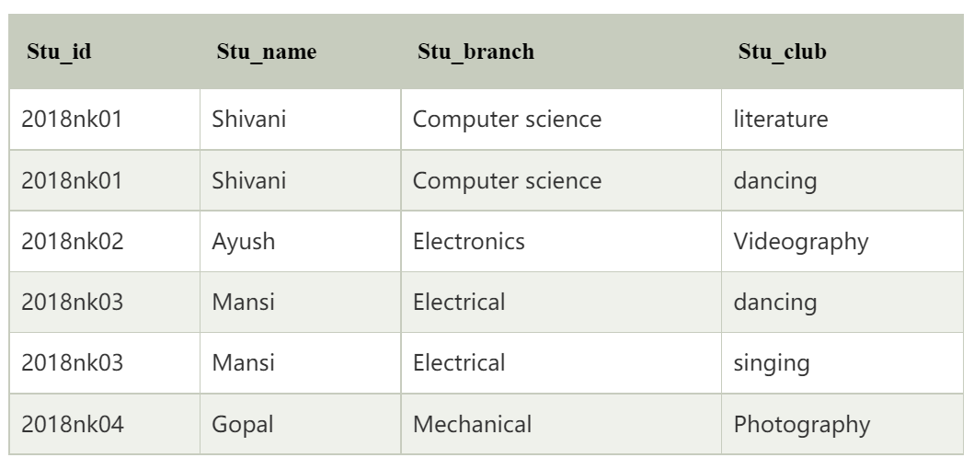
Data modification anomalies example

Slide 6
Data modification anomalies example
Update Anomaly
If Shivani changes her branch from Computer Science to Electronics, then we will have to update all the rows. If we miss any row, then Shivani will have more than one branch, which will create the update anomaly in the table.
Insertion Anomaly
If we add a new row for student Ankit who is not a part of any club, we cannot insert the row into the table as we cannot insert null in the column of stu_club. This is called insertion anomaly.
Deletion Anomaly
If we remove the photography club from the college, then we will have to delete its row from the table. But it will also delete the table of Gopal and his details. So, this is called deletion anomaly and it will make the database inconsistent.

Slide 7

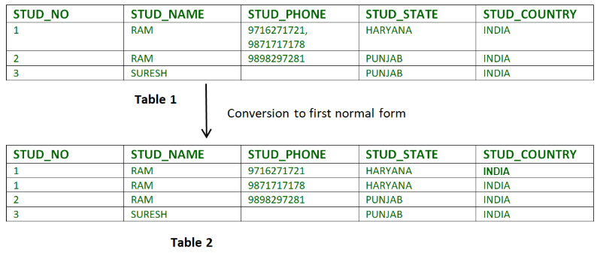
review: 1NF
Each attribute name must be unique
Each attribute value must be single
Each row must be unique
There is no repeating groups
Atomic

Slide 8

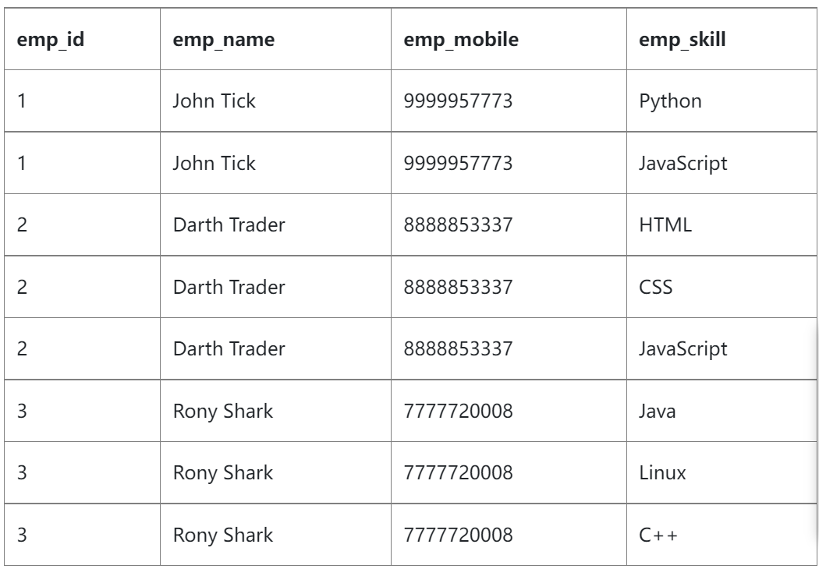
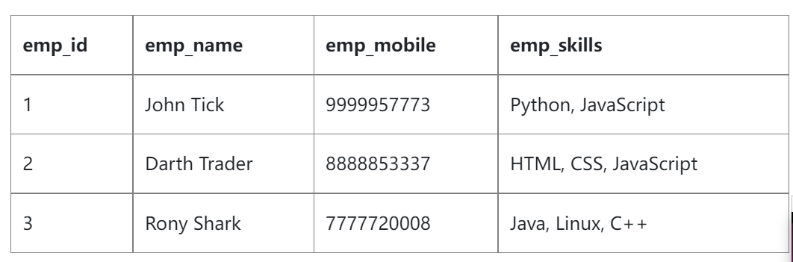
why do we need 2NF
First Normal Form (1NF) does not eliminate redundancy, but rather, it’s that it eliminates repeating groups. Instead of having multiple columns of the same kind of data in a record, (0NF or Unnormalized form) you remove the repeated information into a separate relation and represent them as rows.
redundancy!

Slide 9
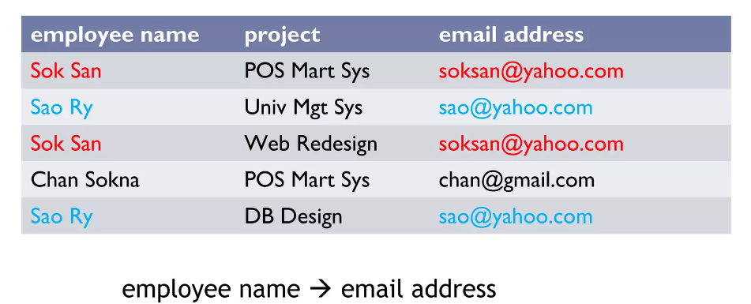

Review: Functional Dependencies
We say an atttribute, B, has a functional dependency on another attribute, A, if for any records, which have the same value for A, then the values for B in these two records must be the same.
A -> B (A determines B or B depends on A)
(Assuming each employee name is unique!)

Slide 10
Review: Partial Dependency
The FD (functional dependency) A->B happens to be a partial dependency if B is functionally dependent on A, and also B can be determined by any other proper subset of A.
Example:
we have a relationship like MO->N, M->P, and P->N. In this case, M is alone capable of determining N. It means that N is dependent partially on MO.

Slide 11
What is 2NF ?
A table is said to be in 2NF if it meets the following criteria:
it’s already in 1NF
has no partial dependency. That is, all non-key attributes are fully dependent on a primary key.
All partial dependencies are removed to place in another table!

Slide 12
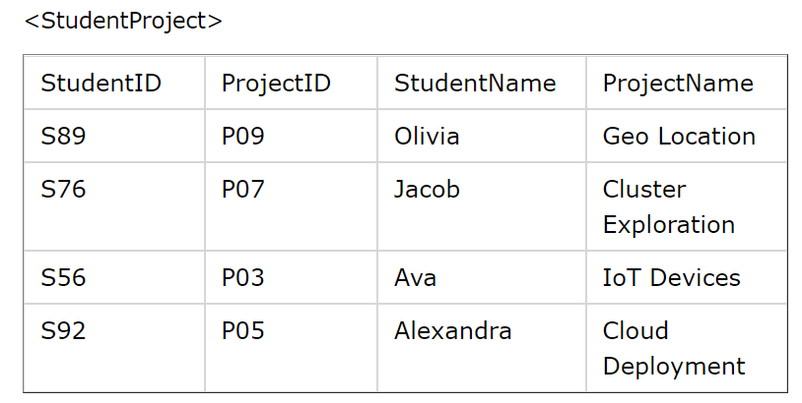
All partial dependencies are removed to place in another table!
primary key:
{StudentID, ProjectID}
We have partial dependencies:
The StudentName can be determined by StudentID(part of primary key)
The ProjectName can be determined by ProjectID(part of primary key)
Solution?

Slide 13
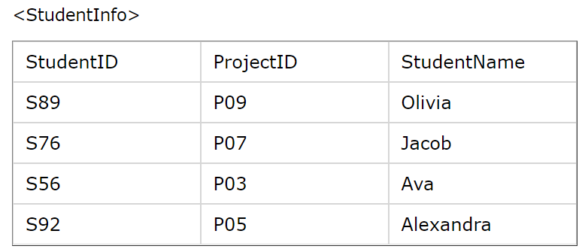
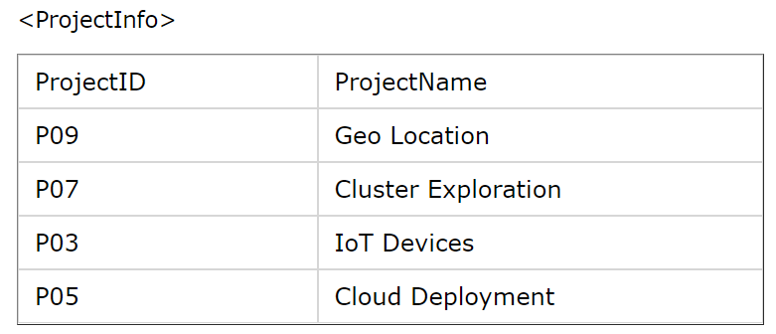
All partial dependencies are removed to place in another table!
Solution!
Remove StudentName and StudentID together to create a new table
OR Remove ProjectName and ProjectID together to create a new table
Remove the non-primary attributes that was removed in the former steps, and leave the remaining table as a new table

Slide 14

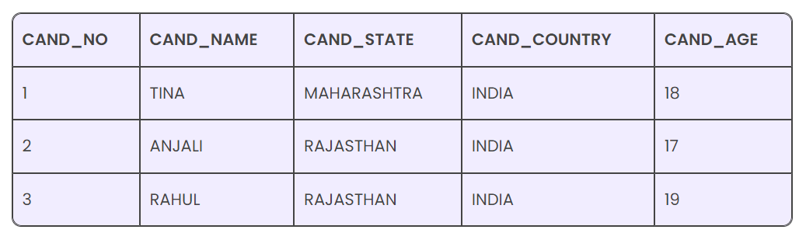
why do we need 3NF
We use the 3NF to reduce any duplication of data and achieve data integrity in a database.
Although Second Normal Form (2NF)relations have less redundancy than those in 1NF, they may still suffer from update anomalies. If we update only one tuple and not the other, the database will be in an inconsistent state. This update anomaly is caused by a transitive dependency. We need to remove such dependencies by progressing to the Third Normal Form (3NF).
update anomaly
redundancy

Slide 15
What is 3NF?
A table is said to be in 3NF if it meets the following criteria:
it’s already in 2NF
has no transitive partial dependency, i.e., non-primary keys don’t depend on other non-primary keys.
3NF ensures that non-key attributes only depend on the primary key
Detailed process:
Eliminate all dependent attributes in transitive relationship(s) from each of the tables that have a transitive relationship.
Create new table(s) with removed dependency.
Check new table(s) as well as table(s) modified to make sure that each table has a determinant and that no table contains inappropriate dependencies.
All transtivity dependency are moved to another table!

Slide 16
What is 3NF?
All transtivity dependency are moved to another table!
Example 1:
A: primary key B,C,D,E: non-primary key
Dependency: {A->BCDE, B->C} transtivity dependency!
Solution: Move B and C to another table

Slide 17
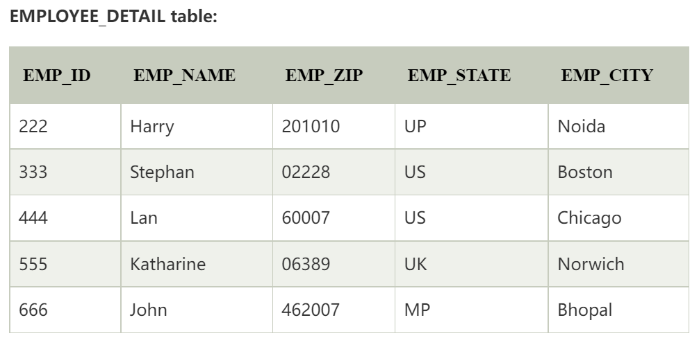
What is 3NF?
All transtivity dependency are moved to another table!
Example 2:
primary key: EMP_ID
EMP_ZIP->EMP_STATE, EMP_CITY
Is this 3NF?

Slide 18
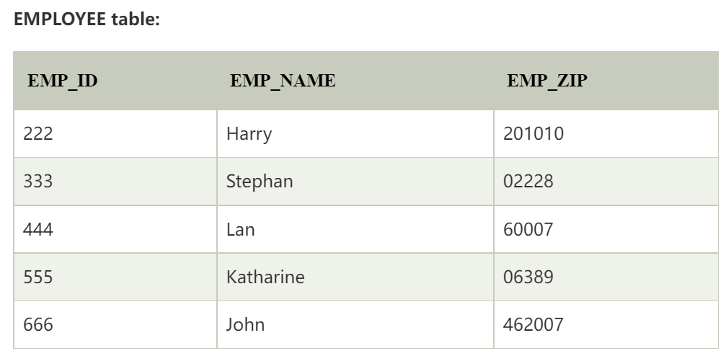
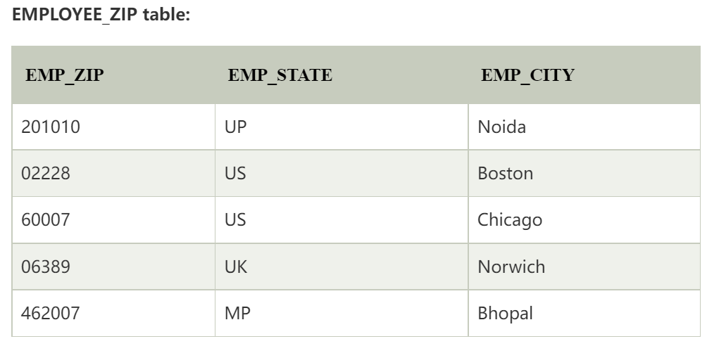
What is 3NF?
All transtivity dependency are moved to another table!
Recall: EMP_ZIP->EMP_STATE, EMP_CITY
Remove EMP_ZIP, EMP_STATE, EMP_CITY together to create a new table

Slide 19

Thanks!

